Slide 1
132-TRP-765-COM-01
COMMUNICATIONS-01
Communication – the 132nd way
Reference:
765th SOP
176th SOP
132nd Virtual Wing Frequency chart
Ground & Visual Approach Charts
M2000C Flight Manual
2017-19-10: Version 1.0

Slide 2
Desired Learning Objectives
Be able to use the ATO to find frequencies
Know where to find information for your flights tasking prior to launch
Principles for writing good AARs and Debriefs
Know how to establish correct communication with FL or ATC
Know agencies you can expect to interact with during a flight
Know how to ask for clearances from the agencies during a flight
Be able to use guard frequency to communicate with others
Be able to taxi on the airfield using ground and VAD charts.
Be able to set Altimeter for airfield QNH and understand why we use QNH
Be able to set Altimeter for Standard Pressure Setting SPS (1013mbar) above 5000ft, and return to QNH below FL050
Notes:
Know 132nd Frequency overview, pre-set frequencies and how to use both radios.
Be able to use guard frequency to communicate with others.
Know how to establish correct communication with ATC before start-up, taxi, line, take-off, departing airspace, returning to airspace and landing.
Be able to establish correct communication (hereafter referred to as Coms) with Flight Lead on any of the two radios
Be able to taxi on the airfield using ground and VAD charts.
Be able to set Altimeter for airfield QNH, understand the meaning of using QNH
Be able to set Altimeter for Standard Pressure Setting SPS (1013mbar) above 5000ft, and return to QNH below FL050
Be able to use the ATO to find frequencies.

Slide 3
Mission Planning & After-action reports
132-TRP-765-COM-01

Slide 4
Frequencies
The 132nd Virtual Wing uses a list of code frequencies for easy reference: http://132virtualwing.org/index.php/page/freqlist
The aircraft will have its radios programmed according to the 132nd Mirage 2000 Presets
Note! Some events will use different presets. If so, preset lists will be provided

Slide 5
Air Tasking Order (ATO)
ATO is a short text describing the tasking for a particular flight. In this example we will look at training flight;
Valid for date and time
Flight number is TR3893
Departure and arrival location is UGTB (Tbilisi-Lochini)
Flight consist of 2x A-10C called DEVIL 4-1 & 4-2
Flight lead decides load out
Primary and secondary radio frequencies for the flight
VTASK/132vW/3893/102000ZFEB2015// TASKUNIT/617th/ICAO:UGTB// AMSNDAT/TR3893/TR/-/-/54/-/-/DEPLOC:UGTB/ARRLOC:UGTB// MSNACFT/2/A-10C/DEVIL41-42/FLIGHT LEAD DISCRETION/-/YELLOW9/ORANGE5//
Notes:
Needs to be updated to a M2000C

Slide 6
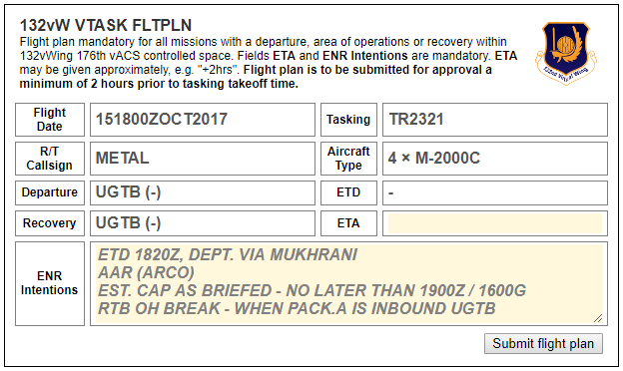
Flight Coms Chatter
Available after being assigned to a flight on an event
Contains information and coordination specific to your flights tasking:
ENR Intentions to be filled out – Important for the controllers and could save you time on departure
Notes:
http://132virtualwing.org/index.php/page/tasking?id=12321

Slide 7
After Action Report (AAR)
A good AAR and debrief is vital for getting the most out of every event – no matter the outcome!
Proper AAR's is very important both for our tactical flying and sharing lessons learned, and must be submitted by every participating member in an event.
Objectives – A list of your flights objectives and outcome
Tactical – Debrief points and points about the flight you want to raise
Try to answer these four questions:
What happened/What did we do? Write a short summary/story of what you did this flight. Remember the 10%-rule* if you go into full story-mode!
What went right? What went according to plan, or had a positive result. Did you or anyone do a good job?
What went wrong? What did not go according to plan, and why. This is perhaps the 2nd most important part of the AAR.
Lessons Learned! The absolutely most important part of the AAR. Here you have a chance to summarize what was learned from the above points.
Design – Technical feedback on the mission, bugs etc. (OPTIONAL);
Admin – Feedback to the event host. Issues etc. (OPTIONAL);
*The 10%-rule is one of the unwritten laws of fighter aviation; If 10% of the story is true, then the story can be regarded as canon

Slide 8
The mirage 2000c
132-TRP-765-COM-01

Slide 9
Radios
The M2000C has 2 radios:
Forward radio is UHF and is referred to as “FRONT” or UNIFORM
Mainly used for inter-flight communications
Only preset frequencies
Aft radio is V/UHF referred to as “AFT” or VICTOR
Used for communication with ATC, AWACS (C2), JTAC, tanker or other flights
Preset and manually set frequencies
We use AFT for monitoring GUARD/Emergency Radio:
Set the V/UHF mode selector switch to “PoL + G”
To broadcast on GUARD, set the AFT frequency mode selector to “G”

Slide 10
Powering Up
Once in cockpit, referred to as “In Pit”:
Connect ground power
Turn on Battery Switch to Marche/ON
This ensures power to the radios and aircraft lights
Set lights according to SOP (or as briefed):
TAXI/Landing lights OFF
Anti- Collision lights OFF
NAV lights ON
Formation lights as briefed
Power up all radios and set frequency:
FRONT mode selector to “M”
FRONT preset selector to preset as briefed
AFT mode selector to “PoL+G”
AFT preset selector to preset 01 unless otherwise briefed
Check in with Flight Lead (see next slide)
Load weapons and countermeasures as briefed
Set up your INS and start alignment – Program waypoints and prepare for start-up

Slide 11
Communicating the 132nd way
132-TRP-765-COM-01

Slide 12
Radio communication is vital to ensure coordination and mission success
Radio communication will have one of three purposes:
Ask for clearance(s)
Give instructions
Receive Instructions
Note:
VHF/UHF Radios are one-way communications only. We want efficient delivery of information by using as few words, in the shortest time possible in order to get our message across while freeing up the radios as much as possible.
AVIATE –> NAVIGATE -> COMMUNICATE
Notes:
“AVIATE -> NAVIGATE -> COMMUNICAT”:
Remember to firstly fly your aircraft. Navigate accordingly, and then communicate. This is priority is especially important if task saturated

Slide 13
During a flight, you (or FL) will talk to FOUR agencies...
GROUND (GND)
TOWER (TWR)
APPROACH (APP)
AWACS (DARKSTAR/MAGIC/CRYSTAL/OVERLORD)
…and request FIVE clearances
GND: Start-up Clearance
GND: Taxi Clearance
TWR: Departure Clearance
AWACS: Clearance to navigate (as fragged)
TWR: Landing Clearance
Notes:
All of the above are minimums. Combat missions might include more.
Control Question: Who do you call in order to get taxi clearance/instruction after you’ve landed and vacated the runway?

Slide 14
The Agencies
The purpose of each agency is to be the controlling authority of a geographical area and its airspace
The agencies provide services and coordination for the flights within their airspace
The illustration on the next slide is taken from the controllers view and shows the four agencies and their geographical responsibilities for Tbilisi-Lochini Airport (UGTB)
Notes:
The exception is of course GROUND, who has no air-space

Slide 15
AWACS
APP
TWR
GND

Slide 16
Note: For this presentation our call-sign will be JEDI8 and we will act as a flight of two M2000Cs – JEDI8-1 (Flight-lead) and JEDI8-2 (Wingman)

Slide 17
In the following slides, you should observe certain patterns in the examples provided:
Communication starts with
«[Station Call-sign], [Caller Call-sign] <message>»
The receiving station replies with
«[Caller], [Station] <message, clearance or instructions>»
The conversation (usually) ends with the caller acknowledging or reading back what was transmitted
«[Station] - turn left heading 130 [Caller]» or the caller just replies with his call-sign – equivalent to saying COPY, or AFIRM or WILCO depending on the context

Slide 18
Communication internal to the flight will be performed on FRONT
Navigation instruction:
“JEDI, check left 130”
“2” “3” etc.
Wingmen reply in sequence, signaling they are acknowledging the transmission and will comply
Communication between flights and agencies are performed on AFT
Clearance or Instructions:
“JEDI8, Tbilisi Approach – Climb to FL250 turn right heading 350”
“Climb FL250, right turn 350, JEDI8”
Throughout this presentation, you will observe the following procedure taking place every time your flight change AFT frequency
FL will inform about the frequency change on FRONT:
“JEDI, push AFT 3”
“2” , “3” etc.
After the last wingman has checked in, FL will wait a few seconds before asking the flight to check in on AFT, confirming that all member are indeed pushed to the correct frequency:
“JEDI8, check in AFT”
“8-2”, “8-3” etc.
Notice how in the last transmission we use our full number in order to not be mistaken for any other FLs wingmen

Slide 19
Flight’s Internal Coms
All communications internal to the flight is transmitted on FRONT. Once the flight is airborne it becomes vital that each member knows where the others are. This is done by using specific words, called Brevity codes
Visual is called when you have another aircraft in sight, e.g.;
«2, visual on Lead»
«2, visual 1 & 3»
«2, visual 1, blind 3»
To assist in overall Situational Awareness the visual call can add the location where his other flight will have to look in order to see you, e.g. «2 visual on Lead, your 5 o’clock low». FL now knows he should check his 5 o’clock low to get you visual.
Blind is called when you are not visual on another aircraft and you altitude and heading is added to the announcement;
«2, blind on Lead, 4100ft heading 020»
«2, blind on Lead, FL085 heading 190»
In case of a Blind call the other aircraft should reply immediately with status. If FL is Visual then de-confliction is still maintained. If not then you must recover to level or climbing flight immediately in order ensure de-confliction.

Slide 20
For navigation there also some specific Brevity used;
Check left/right (heading), Turn in the direction given and maintain the new heading, e.g.;
«2, check left 90», meaning turn left 90 degree
«2, check right heading 180», meaning turn right until heading 180
Established means that you are now currently at the specified altitude, heading, location etc.;
«2, established heading 020»
Saddled means you are in formation, where FL wanted you to be
«2, saddled left»
Pad-locked means you are keeping your eyes on FL, mirroring his move and keeping formation. FL is now free to maneuver without calling out position changes.
«2, pad-locked»
If you are pad-locked, and FL requests you to do a task you deem unable to do without taking your eyes off of him – you MUST report. DO NOT TAKE YOUR EYES OF LEAD!
«2, unable - pad-locked»
«1 copies – Kick out»
Kick Out is an instruction to put some space between you and FL
«Kick out 1 nautical mile, tactical spread»
«2»

Slide 21
Start-up Clearance - GND
Check-in with Flight-Lead (FL) on FRONT after powering the aircraft:
“JEDI8-2, radio check FRONT stud 15”
”JEDI8-2, JEDI8-1 read you 0-5”
FL might perform a full flight check:
“JEDI8, check-in”
“2”
FL will ask ground (GND) for startup clearance and weather information
“Lochini Ground, JEDI8-1 two times M2000 parked APRON 1. Request start-up and weather”
“JEDI8-1, Ground. Winds calm, QNH 1003. Start-up approved”
Sometimes ATIS (weather information) is issued by ATC:
“Lochini Ground, JEDI8-1 two times M2000C parked APRON 1, with information ROMEO, request start-up”
“JEDI8, Ground. Start-up is approved, information ROMEO is active. Wind 150 degrees 4 knots, QNH 1022”
In both cases, FL will reply with:
“Start-up approved, QNH XXXX, JEDI8-1” Check altimeter settings – Set to QNH accordingly
Once start-up clearance has been issued, Flight Lead will notify his flight when to start the engines.
Notes:
Checking in procedure changed.

Slide 22
Taxi Clearance - GND
After start-up is complete, check-in with Flight-Lead (FL):
“2, ready to taxi”
FL will ask ground (GND) for taxi clearance to the currently active runway:
“Lochini Ground, JEDI8-1 – Request taxi to active.”
“JEDI8-1, Ground. Taxi to active Runway 31L is approved. Taxi via CHARLIE, APRON 4 on to ECHO – crossing NOVEMBER, continue on ECHO – Hold short 31L”
“Lochini Ground, JEDI8-1. Taxi to 31L via CHARLIE, APRON 4 on to ECHO – crossing NOVEMBER and continuing on ECHO. Hold short of active”
FL will call his flight to start taxiing:
“1 is rolling”
“2”
Holding short of active, FL will call GND again
“Lochini Ground, JEDI8-1 holding short 31L”
“JEDI8-1, Ground. Contact Tower on 138.2”
“Contact TOWER on 138.2, JEDI8-1”
FL has been instructed to contact another agency, requiring a frequency change. As described earlier, all frequency changes follow a similar pattern. Starting with FL giving instructions on FRONT to his flight:
“Flight push AFT 2”
“2”
Notes:
Checking in procedure changed.

Slide 23
Departure Clearance - TWR
After switching to TOWER frequency, FL will continue the procedure and ask his flight to check in on AFT before continuing his communication with TOWER
“JEDI8-1, check-in AFT”
“8-2”, “8-3” etc.
“Lochini Tower, JEDI8-1. Holding short 31L”
“JEDI8-1, line up runway 31L, call ready to receive departure clearance”
“Lining up, JEDI8-1”
FL will communicate any instructions to his flight on line-up on FRONT at this point
“Lochini Tower, JEDI8-1. Lined up and ready to receive departure clearance”
“JEDI8-1, Tower. After departure, continue runway heading and report passing 5000ft”
“Tower, JEDI8-1. Continue runway heading, report passing 5000”
“JEDI8-1, report ready for departure”
FL will check with his wingmen that his flight is ready for departure
“Tower, JEDI8-1 ready for departure”
“JEDI8-1, Lochini Tower. Wind 150 at 4 knots. Runway 31L cleared for take-off”
“Cleared for take-off, JEDI8-1”
At this point FL will give any last remarks to his flight before taking off. At 5000ft he will report to TOWER as requested above:
“Tower, JEDI8-1 passing 5000ft”
“JEDI8-1, contact APPROACH on 127.1”
“Contact APPROACH on 127.2, JEDI8-1”
Notes:
NOTE that the word take-off is not used until actuall take-off clearence is given!

Slide 24
Clearance to Navigate – APP/AWACS
After switching to APPROACH frequency, FL will again perform check-in on AFT as before
FL will then check in with APPROACH:
“Tbilisi Approach, JEDI8-1 – Passing 5000ft and climbing, heading 301”
“JEDI8-1, Approach. Positive radar contact. Climb and maintain FL240, turn left inbound Mukhrani”
“Climb and maintain FL240, left turn inbound MUKHRANI– JEDI8-1”
When the flight is about to cross out of the TMA, approach will push the flight onto the next controlling agency – AWACS. AWACS is controlled by a Senior Weapons Director (SD) with call sign DARKSTAR and is the highest controlling agency within the 132nd
“JEDI8-1, Approach. Contact DARKSTAR on 237.0”
“Contacting DARKSTAR on 237.0, JEDI8-1”
FL and the flight will again perform the normal procedure for frequency changes before checking in with DARKSTAR
“DARKSTAR , JEDI8-1 with you at FL240 passing MUKHRANI.”
DARKSTAR will at this point perform an authentication using the AET-100 table.
“JEDI8-1, DARKSTAR . Authenticate ALPHA DELTA TANGO”
“JEDI8-1 authenticates ZULU. Authenticate ALPHA KILO INDIA”
“DARKSTAR authenticates HOTEL. JEDI8-1 send check-in”
“DARKSTAR, JEDI8 is two times M2000C checking in as fragged”
“JEDI8-1, DARKSTAR. Copy, continue as fragged”
“JEDI8-1”

Slide 25
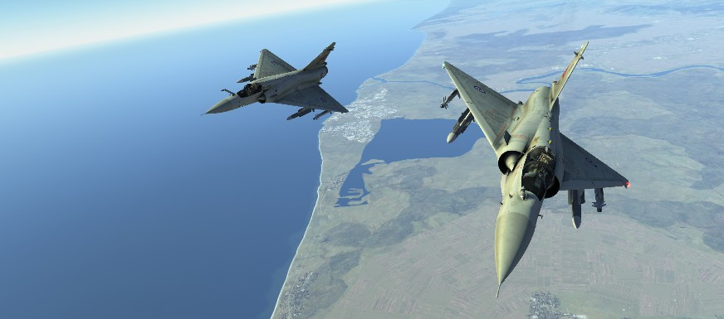
Your flight at this point!
Bulldog and Hahn in close formation over Lake Poti
Your flight has now completed a departure from the TMA and is ready to continue on its mission as fragged. DARKSTAR might choose to push you into another Weapons Director, like MAGIC or CRYSTAL. However, A2A engagements and its coms is beyond the scope of this presentation.

Slide 26
What did we learned so far:
How to prepare ourselves and the aircraft in order to use radio efficiently
The necessary clearances needed and what agencies are able to provide them
There is a pattern and a reputability to they “language” spoken on coms. Recognize this pattern, and the rest will come easily
During your flights, think about the next step. What clearances will you need next? Go trough the conversation mentally
Listen in on what your Flight Lead is saying on AFT. What will he ask for next?
Should you end up as a singleton – Don’t panic! Remember the clearances and their sequence. On returning to base, the procedure is almost the exact opposite.
Remember that instructions or messages are of no use if it is not received or misunderstood. There is no shame in asking the agency to repeat the message. To the best of your ability - make sure you received everything correctly
Think about what you are going to say / answer BEFORE you press the PTT button. We don’t want to be blocking the whole frequency while thinking.
Notes:
4 stations

Slide 27
Returning to Base
The procedure for getting home can be broken into the following steps:
Checking out with AWACS
Checking in with APPROACH and continue trough his airspace
Check in with TOWER to receive final vectors and Clearance to Land
Check in with GROUND to receive taxiing instructions back to parking
It is more or less the exact opposite of what we do on departure!
Depending on the situation and metrological conditions, agencies will give you instructions on where to fly and what altitudes to keep in order to get back home safely. There is too much variation to what could be transmitted in order to give examples for everything in this presentation. However, these instructions are fairly straight forward and self-explanatory.

Slide 28
There are a few terms that you might encounter on your way back:
Straight-in Approach: This is the normal airliner type landing where you come straight on to the runway from 8-10nm on a nice glide-slope
Overhead Break: This is the preferred way of recovering military aircraft. Fighters come in fast, on runway heading overflying the runway, at approximately 1500ft AGL at 350kt and will perform a medium to high-G 180° turn down wind for final - bleeding off speed in the process
Join [left-hand] circuit [or pattern] – you are number 2 for landing: There are multiple flights waiting to land. ATC is putting all flights into a rectangular pattern on the cold side of the runway and is instructing your flight to join. He is also instructing that your flight is number two in line for landing.
Pattern Altitude: The altitude flights entering into the pattern is expected to keep
Further explanations can be found in the 176th SOP, Appendix A

Slide 29

The Mirage is a fast jet - Check in with APPROACH early!
Check in with APPROACH while still a few minutes out of the TMA. He will be able to provide better service, and you reduce the risk of being put into a holding pattern – waiting to descend. We want to get back on ground and get ready for the next one!

Slide 30
Checking Out with AWACS
The flight has finished its mission, and FL will state his intentions to AWACS:
“DARKSTAR, JEDI8 has finished our business, JOKER and RTB at this time”
“JEDI8, DARKSTAR copies all. FL220 for transit, inbound MUKHRANI”
“FL220, JEDI8”
A few minutes before reaching the TMA, FL will check out with AWACS:
“DARKSTAR, JEDI8 – Just outside the TMA, leaving your frequency”
“JEDI8, DARKSTAR copies. APPROACH frequency is 127.2 So long!”

Slide 31
Checking in with Approach
After having checked out with AWACS, FL will check in with APPROACH to let him know his intentions and give him an idea of where the flight is in relation to his airspace
We can expect APPROACH to give us vectors and altitude necessary to position us towards the runway or pattern before handing us off.
“APPROACH, JEDI8 with you from the WEST – FL220, inbound for full stop landing”
“JEDI8, APPROACH. Identified, decent FL060 and turn right inbound Lochini. Report runway in sight”
“Wilco, FL060 inbound Lochini. JEDI8”
As we continue towards the airfield – reaching our instructed altitude and acquire visual contact with the runway, we do as instructed.
“APPROACH, JEDI8 – FL060, runway in sight”
“Copy that JEDI8, contact TOWER on 138.2. So long”
“Tower on 138.2, JEDI8”
Optionally APPROACH might also contact FL to initiate the push to TOWER
“JEDI8, contact TOWER – frequency 138.2”
“Tower 138.8, JEDI8”

Slide 32
Checking in with Tower – OH BREAK
The flight is now on the home stretch. Flight has been pushed to Tower – and again FL will check in, stating intensions and giving a rough position
“Tower, JEDI8 - FL060 just short of Lochini inbound for full stop landing via overhead break”
“JEDI8, Tower - Copy. Turn left 320 for runway 31 Left. Cleared overhead break. Report downwind.”
“Left 320 for 31 Left, cleared overhead break. Wilco, JEDI8”
Tower gave instructions to report downwind. The flight will perform the overhead break, and then report in. In the following example, the flight is landing as singletons – not in formation. This means each member will have to report downwind and final on his own.
“TOWER, JEDI8-1 down wind”
“JEDI8-1, Copy – Report final with gears down and locked”
“JEDI8-1”
If all went well, JEDI8-2 will be out of the break about 5 seconds after 8-1
“TOWER, JEDI8-2 down wind”
“JEDI8-2, Copy – Report final with gears down and locked”
“JEDI8-2”
While FL performs his landing, JEDI8-2 will now configure the aircraft for landing, turn in on final and report in
“TOWER, JEDI8-2 on final. Gears down and locked”
“JEDI8-2, wind 150 degrees at 10 knots. Runway 31 Left cleared to land
Once landed, JEDI8-2 will vacate the runway and hold short on the taxiway
“TOWER, JEDI8-2 runway vacated”
“JEDI8-2, TOWER. Copy – contact ground on 138.1. Good night”
“Ground 138.1, JEDI8-2 – Good night

Slide 33
Checking in with Ground
Contact Ground for taxi clearance and instructions, e.g.;
“Ground DEVIL 4-1 runway vacated”
“DEVIL 4-1 Ground, taxi parking Apron One via Bravo – the Parallel and Alpha”
“Via Bravo, the parallel and Alpha for Apron One parking DEVIL 4-1”
Contact Ground once flight has parked, e.g.;
“Ground DEVIL 4-1 parked Apron One and shutting down, so long”
“Ground copies have a good day”
The flight is now on the ground, holding at a taxiway just off of the runway. FL will contact ground to request taxi clearance. If you landed as singleton, each flight will have to request their own clearance
«GROUND, JEDI8-1 holding at Bravo, runway vacated»
«JEDI8-1, GROUND – Taxi to parking APRON 1 via BRAVO and CHARLIE»
«APRON 1 via BRAVO and CHARLIE, JEDI8-1»
As the flight arrives at APRON 1, FL will notify GROUND
«GROUND, JEDI8-1 parked APRON 1 and shutting down. So long»
«GROUND copies. Have a good day»

Slide 35
Altitudes and flight levels
QNH (Naval Height)
“Height” - Based on setting a locally provided altimeter setting which is determined by adjusting an altimeter on the ground until it reads the station's correct elevation above the sea level reference datum. As the aircraft altimeter is set for QNH before taxi the altimeter will show runway height above sea level, i.e. app. 1560ft for Lochini.
When altimeter is set for QNH the vertical position of the aircraft is referred to as altitudes in feet.
SPS/QNE (En Route)
“En Route” - Based on setting 29.92 inch Mercury or 1013.2 hPa, gives height above a theoretical datum which is not adjusted for atmospheric conditions.
In order to obtain the same reference between flight coming from different airports the 132nd Virtual Wing uses Standard Pressure Setting/QNE when en route at higher altitudes.
When altimeter is set for SPS/QNE the vertical position of the aircraft is referred to at flight level in 100 feet, e.g. altimeter shows 12000ft which translate to FL120.

Slide 36
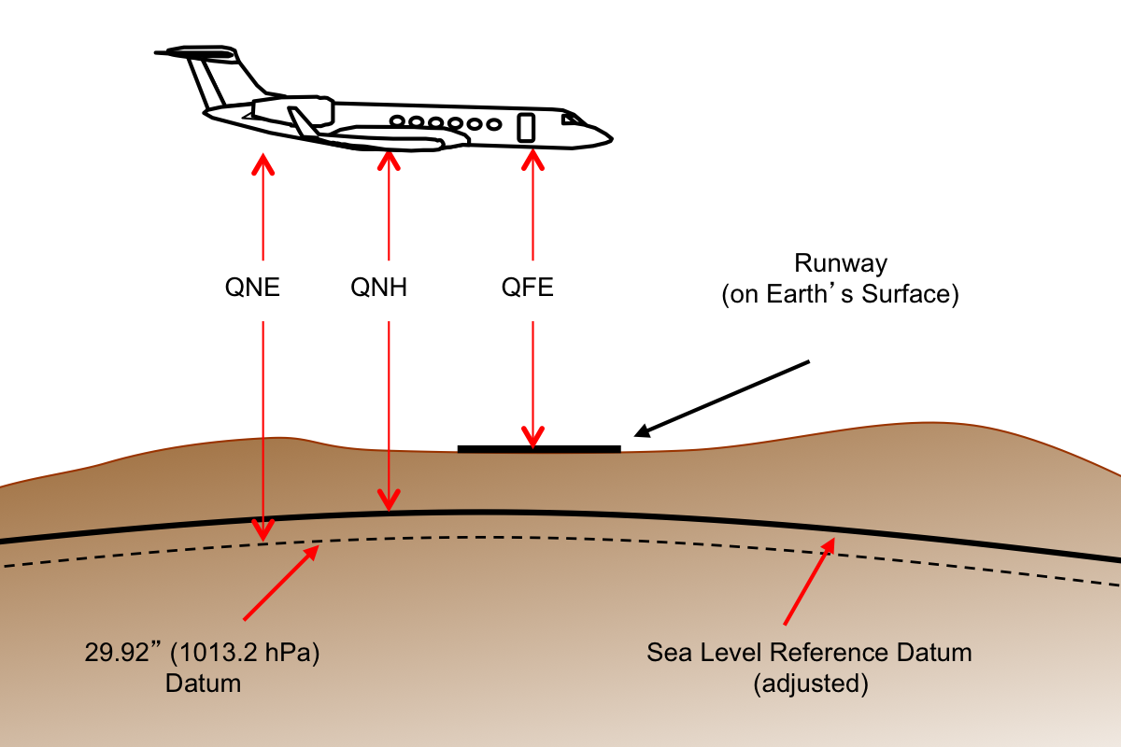
Altitudes and flight levels (cont.)
QFE (Field Elevation)
“Field Elevation” - Based on setting a locally provided altimeter setting which is determined by adjusting an altimeter on the ground until it reads zero. QFE allows us to read height above the runway, i.e. while on the runway altimeter will show 0 feet.
When altimeter is set for QFE the vertical position of the aircraft is referred to as height in feet.

Slide 37
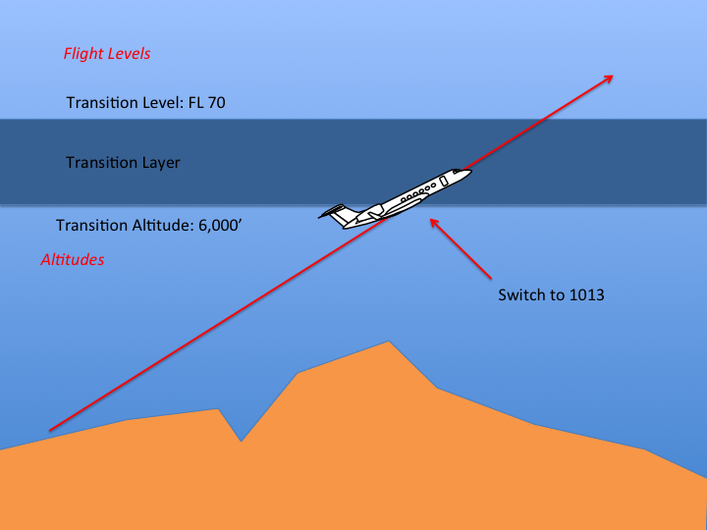
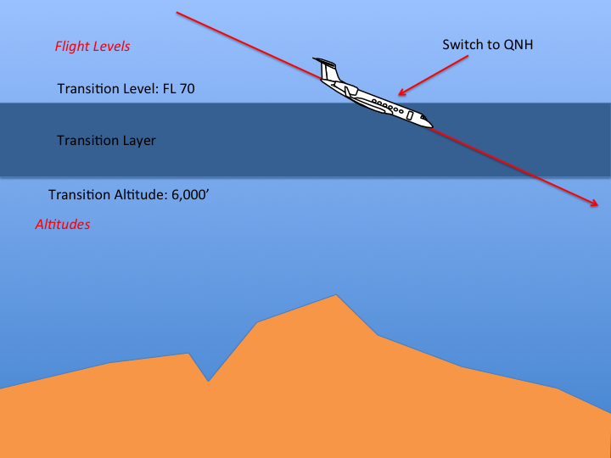
Altitudes and flight levels (cont.)
Transition Altitude
Highest possible altitude for referring to the aircrafts vertical position. Above this vertical position the altitude does not exist. So once climbing above the transition altitude the Pilot must change to SPS/QNE
Transition Level
Lowest possible flight level for referring to the aircrafts vertical position. Below this vertical position the flight level does not exist. So once descending below the transition level the Pilot must change to local QNH.

